Slide 1

Mumbai Price Prediction AI Model
“Know where Mumbai’s property prices are headed — before anyone else”

Slide 2
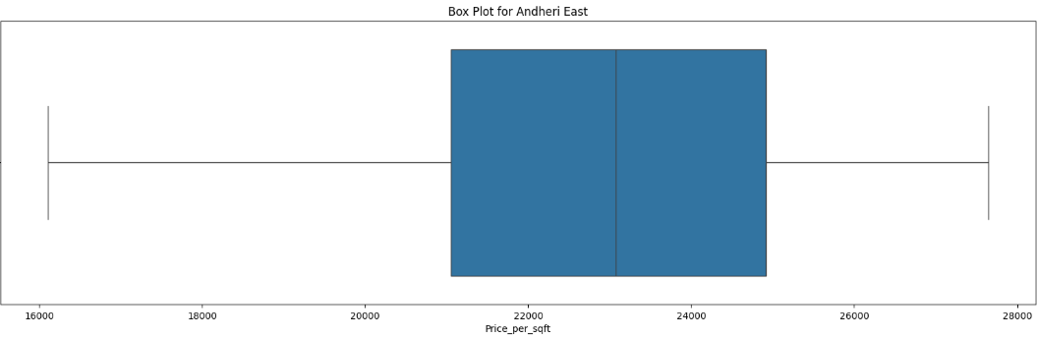
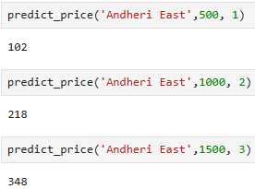
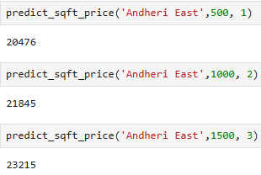
Avg. Price for Flat in Andheri East :
1 BHK ( 500 sqft ) :
- 102 Lakhs ( Rs 20476 per sqft )
2 BHK ( 1000 sqft ) :
- 218 Lakhs ( Rs 21845 per sqft )
3 BHK ( 1500 sqft ) :
- 348 Lakhs ( Rs 23215 per sqft )

Slide 3
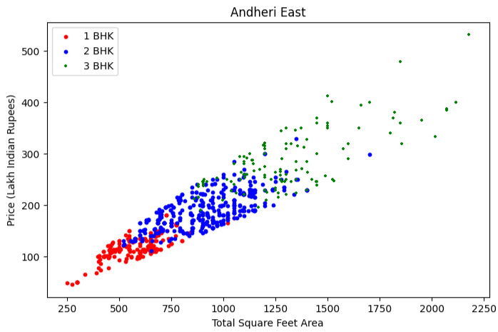

Slide 4
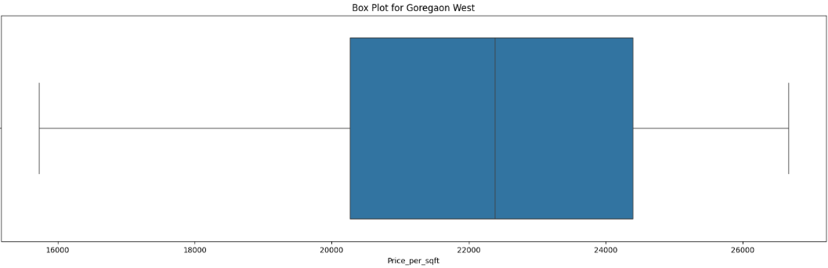
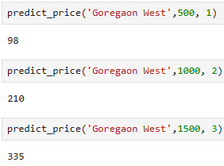
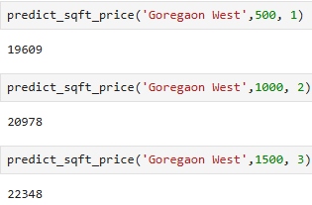
Avg. Price for Flat in Goregaon West :
1 BHK ( 500 sqft ) :
- 98 Lakhs ( Rs 19609 per sqft )
2 BHK ( 1000 sqft ) :
- 210 Lakhs ( Rs 20978 per sqft )
3 BHK ( 1500 sqft ) :
- 335 Lakhs ( Rs 22348 per sqft )

Slide 5
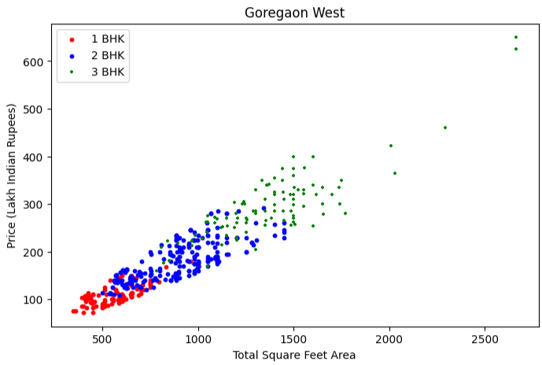

Slide 6
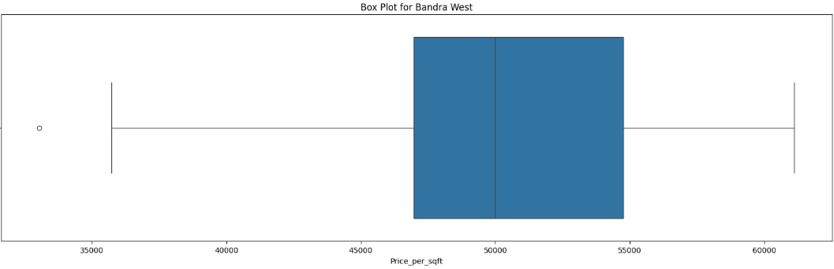
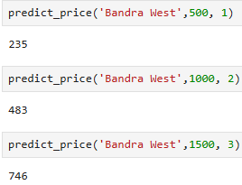
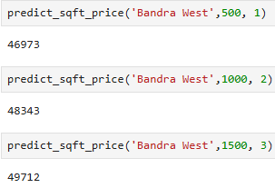
Avg. Price for Flat in Bandra West :
1 BHK ( 500 sqft ) :
- 235 Lakhs ( Rs 46973 per sqft )
2 BHK ( 1000 sqft ) :
- 483 Lakhs ( Rs 48343 per sqft )
3 BHK ( 1500 sqft ) :
- 746 Lakhs ( Rs 49712 per sqft )

Slide 7
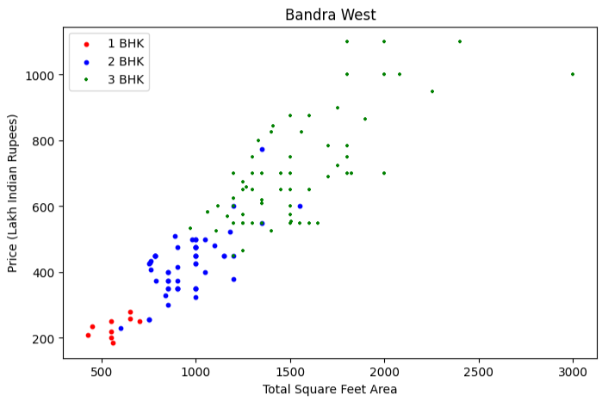

Slide 8
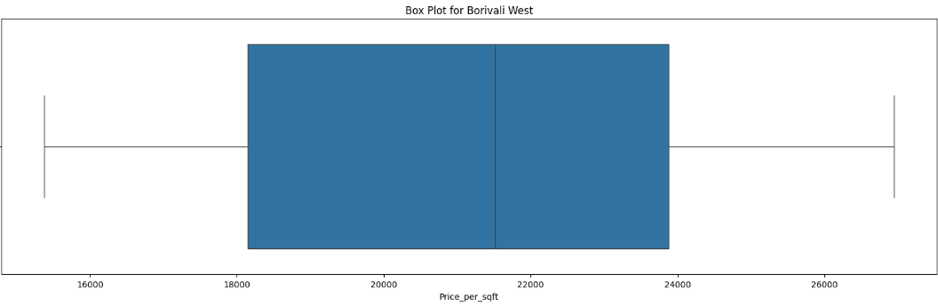
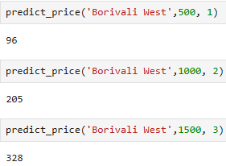
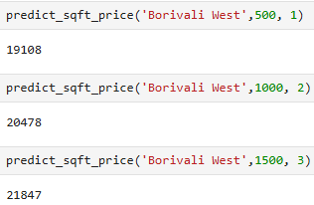
Avg. Price for Flat in Borivali West :
1 BHK ( 500 sqft ) :
- 96 Lakhs ( Rs 19108 per sqft )
2 BHK ( 1000 sqft ) :
- 205 Lakhs ( Rs 20478 per sqft )
3 BHK ( 1500 sqft ) :
- 328 Lakhs ( Rs 21847 per sqft )

Slide 9
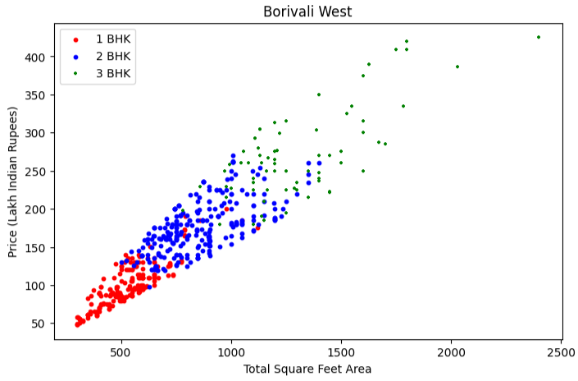

Slide 10
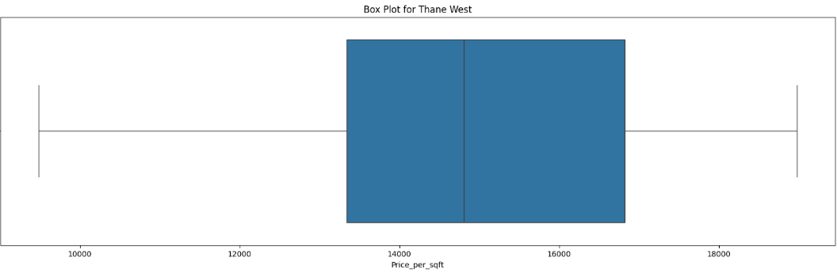

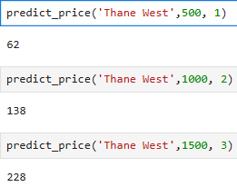
Avg. Price for Flat in Thane West :
1 BHK ( 500 sqft ) :
- 62 Lakhs ( Rs 12432 per sqft )
2 BHK ( 1000 sqft ) :
- 138 Lakhs ( Rs 13802 per sqft )
3 BHK ( 1500 sqft ) :
- 228 Lakhs ( Rs 15171 per sqft )

Slide 11
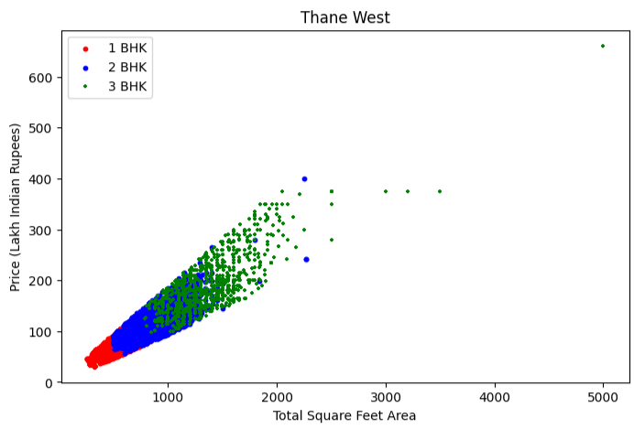

Slide 12
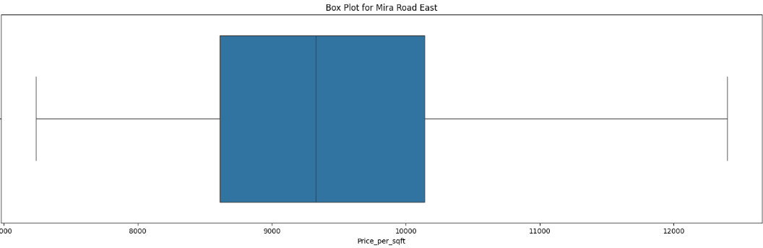
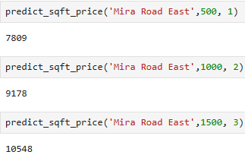
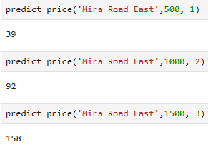
Avg. Price for Flat in Mira Road East :
1 BHK ( 500 sqft ) :
- 39 Lakhs ( Rs 7809 per sqft )
2 BHK ( 1000 sqft ) :
- 92 Lakhs ( Rs 9178 per sqft )
3 BHK ( 1500 sqft ) :
- 158 Lakhs ( Rs 10548 per sqft )

Slide 13
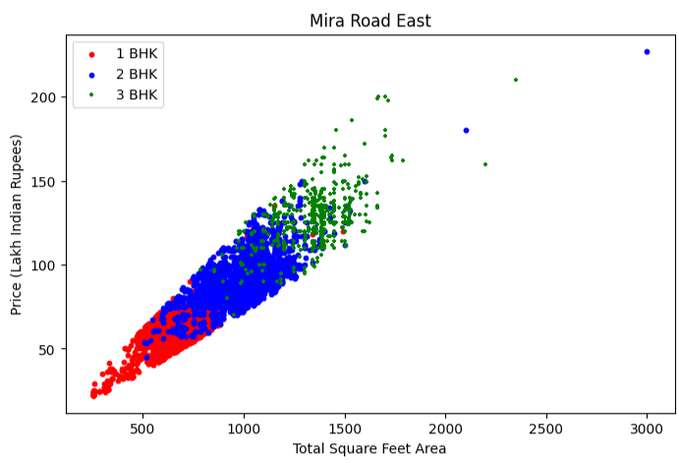

Slide 14
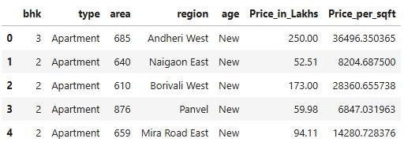
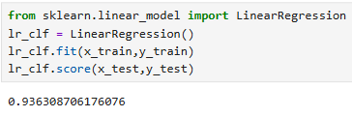

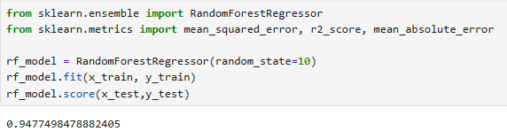
Dataset, Shape & Accuracy of AI Model

Slide 15
Regions covered for training the AI Model
'Agripada' 'Airoli' 'Ambernath East' 'Ambernath West' 'Andheri' 'Andheri East' 'Andheri West' 'Anjurdive' 'Badlapur East' 'Badlapur West' 'Bandra East' 'Bandra Kurla Complex' 'Bandra West' 'Belapur' 'Bhandup East' 'Bhandup West' 'Bhayandar East' 'Bhayandar West' 'Bhiwandi' 'Boisar' 'Borivali East' 'Borivali West' 'Byculla' 'Chembur' 'Chembur East' 'Colaba' 'Dadar East' 'Dadar West' 'Dahisar' 'Dahisar East' 'Dahisar West' 'Dattapada' 'Deonar' 'Diva' 'Dombivali' 'Dombivali East' 'Dombivli (West)' 'Dronagiri' 'Ghansoli' 'Ghatkopar' 'Ghatkopar East' 'Ghatkopar West' 'Girgaon' 'Goregaon' 'Goregaon East' 'Goregaon West' 'Hiranandani Estates' 'Jogeshwari East' 'Jogeshwari West' 'Juhu' 'Juinagar' 'Kalamboli' 'Kalwa' 'Kalyan East' 'Kalyan West' 'Kamothe' 'Kandivali East' 'Kandivali West' 'Kanjurmarg' 'Kanjurmarg East' 'Karanjade' 'Karjat' 'Kasheli' 'Kewale' 'Khar' 'Khar West' 'Kharghar' 'Khopoli' 'Koper Khairane' 'Koproli' 'Kurla' 'Kurla West' 'Lower Parel' 'Magathane' 'Mahalaxmi' 'Mahim' 'Malad East' 'Malad West' 'Marine Lines' 'Matunga' 'Mazagaon' 'Mazgaon' 'Mira Road East' 'Mira Road and Beyond' 'Mulund East' 'Mulund West' 'Nahur East' 'Naigaon East' 'Nala Sopara' 'Nalasopara East' 'Nalasopara West' 'Napeansea Road' 'Neral' 'Nerul' 'Nilje Gaon' 'Palava' 'Palghar' 'Panvel' 'Parel' 'Powai' 'Prabhadevi' 'Rasayani' 'Sanpada' 'Santacruz East' 'Santacruz West' 'Seawoods' 'Sector 17 Ulwe' 'Sector 19 Kharghar' 'Sector 20 Kamothe' 'Sector 20 Kharghar' 'Sector 21 Kamothe' 'Sector-18 Ulwe' 'Sewri' 'Shil Phata' 'Sion' 'Taloja' 'Taloje' 'Tardeo' 'Thane' 'Thane East' 'Thane West' 'Titwala' 'Ulwe' 'Umroli' 'Vangani' 'Vasai' 'Vasai West' 'Vasai east' 'Vashi' 'Vikhroli' 'Ville Parle East' 'Ville Parle West' 'Virar' 'Virar East' 'Virar West' 'Wadala' 'Wadala East Wadala' 'Worli' 'matunga east' 'mumbai' 'other'

